Slide 1
Multimodal Intent Recognition
Guide by
Prof. Shruti Bhilare
Presented By
Swayam Patel (M.Tech Software Systems)
Talaksh Rabari (M.Tech Software Systems)

Slide 2
Outline
  Introduction
  Motivation
  Literature Review
  TCL-MAP Pipeline
  TCL-MAP Architecture
  MAP Module
  DataSet
  Experimental Results
  Literature Review: MISA
  MISA Architecture
  Dataset Profile & MISA Performance
  Conclusion
  Future Work
  References

Slide 3
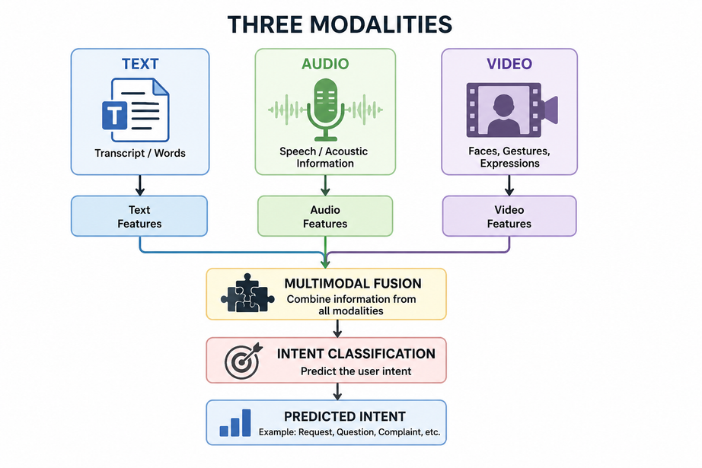
Introduction to Multimodal Intent Recognition
  Intent Recognition is the task of identifying the underlying goal or intention behind a person's communication. Instead of only analyzing the words that a person speaks, it tries to understand what the speaker actually wants to accomplish.
  Identifies the user's underlying intent from communication
  Uses Text, Audio, and Video modalities.
  Learns both verbal and non-verbal cues.
Why Multimodal?
  Text may miss emotional context
  Audio provides tone and emphasis.
  Video captures facial expressions and gestures.
Example
Text: "That's great."
😊 Smiling face + cheerful voice → Praise
😒 Rolling eyes + sarcastic tone → Sarcasm/Criticism

Slide 4
Motivation
  Existing multimodal intent recognition models show promising performance but still struggle to effectively capture complementary information from text, audio, and video.
  Most state-of-the-art methods are evaluated on benchmark datasets; their performance on newer datasets such as IntentHQ remains largely unexplored.
  Reproducing recent architectures such as TCL-MAP and comparing them with MISA helps validate published results and identify their strengths and limitations.
  A systematic comparison provides insights into how different multimodal representation learning and fusion strategies affect intent recognition performance.
  This study establishes a strong baseline for developing more robust multimodal intent recognition models in future work.

Slide 5
Literature Review
  We studied two key papers in multimodal intent recognition: MISA (Modality-Invariant and -Specific Representations) and TCL-MAP (Token-Level Contrastive Learning with Modality-Aware Prompting).
  MISA learns shared (modality-invariant) and private (modality-specific) representations for text, audio, and video, using CMD, difference, and reconstruction losses.
  TCL-MAP aligns modalities through modality-aware prompting and refines representations using token-level contrastive learning.
  We reproduced the results of TCL-MAP, since it represents the more recent, state-of-the-art approach.
  Reproduction used the datasets reported in the original TCL-MAP paper — MIntRec and MELD-DA — along with an additional dataset, IntentHQ, to test generalization beyond the paper's original benchmarks.

Slide 6
Literature Review
TCL-MAP (AAAI 2024)
Paper: Token-Level Contrastive Learning with Modality-Aware Prompting for Multimodal Intent Recognition
Conference: AAAI 2024
Authors: Qianrui Zhou, Hua Xu, Hao Li, Hanlei Zhang, Xiaohan Zhang, Yifan Wang, Kai Gao
TCL-MAP Framework
  Extracts text, audio, and video features.
  Aligns multimodal features using Similarity-Based Modality Alignment.
  Generates Modality-Aware Prompts using cross-modal attention.
  Fuses features using the Multimodal Adaptation Gate (MAG).
  Applies Token-Level Contrastive Learning for accurate intent classification.

Slide 7
TCL-MAP Pipeline
Step 1: Feature Extraction
  Extract text, audio, and video features using BERT, Wav2Vec 2.0, and Swin Transformer.
Step 2: Similarity-Based Modality Alignment
  Align multimodal features into a common semantic space to reduce the modality gap.
Step 3: Modality-Aware Prompt Generation
  Generate multimodal prompts using cross-modal attention from the aligned features.
Step 4: Prompt-based Augmentation
  Concatenate the generated prompt with the text tokens and construct:
  Normal Sample (with [MASK] token)
  Augmented Sample (with Intent Label token)
Step 5: Token-Level Contrastive Learning & Intent Classification
  Apply MAG fusion and optimize using NT-Xent Loss to learn discriminative representations.
  Use the learned multimodal representation to predict the final intent category.

Slide 8
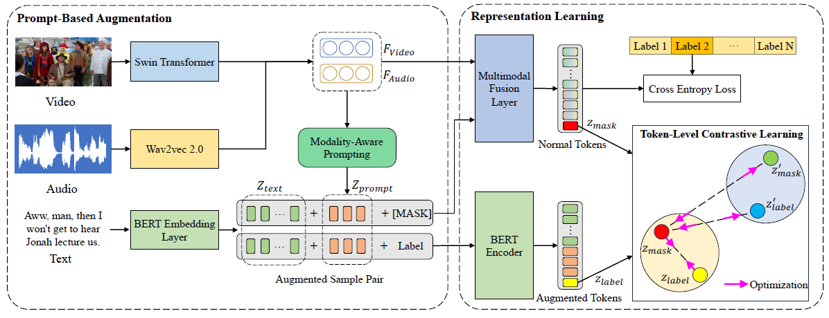
TCL-MAP Architecture

Slide 9
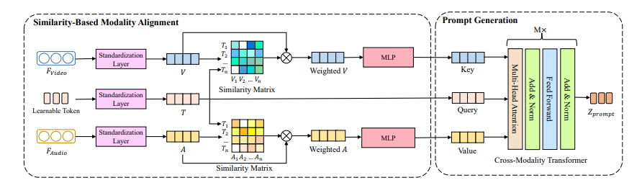
MAP Module

Slide 10
DataSet
Dataset | Samples | Classes
MIntRec | 2224 | 20
MELD-DA | 9988 | 12
IntentHQ | 5168 (4547) | 23

Slide 11
Experimental Results on TCL
Dataset | Paper ACC (%) | ReproducedWF1 (%) | Reproduced ACC(%)
MIntRec | 73.62 | 73.02 | 73.71
MELD-DA | 61.75 | 50.6 | 61.66
IntentHQ | 52.50 | 45.4 | 47.3

Slide 12
Literature Review: MISA
MISA (ACM Multimedia 2020)
Paper: MISA: Modality-Invariant and Modality-Specific Representations for Multimodal Sentiment Analysis
Conference: ACM Multimedia (MM 2020)
Authors: Devamanyu Hazarika, Roger Zimmermann, Soujanya Poria
MISA Framework
  Extracts text, audio, and visual features using BiLSTM encoders.
  Learns modality-invariant (shared) and modality-specific (private) representations.
  Aligns shared representations across modalities using Central Moment Discrepancy (CMD) Loss.
  Separates shared and private features using Difference Loss.
  Preserves modality information through Reconstruction Loss.
  Fuses shared and private representations using a Transformer Encoder.
  Performs multimodal sentiment/intention classification using a fully connected classifier.

Slide 13
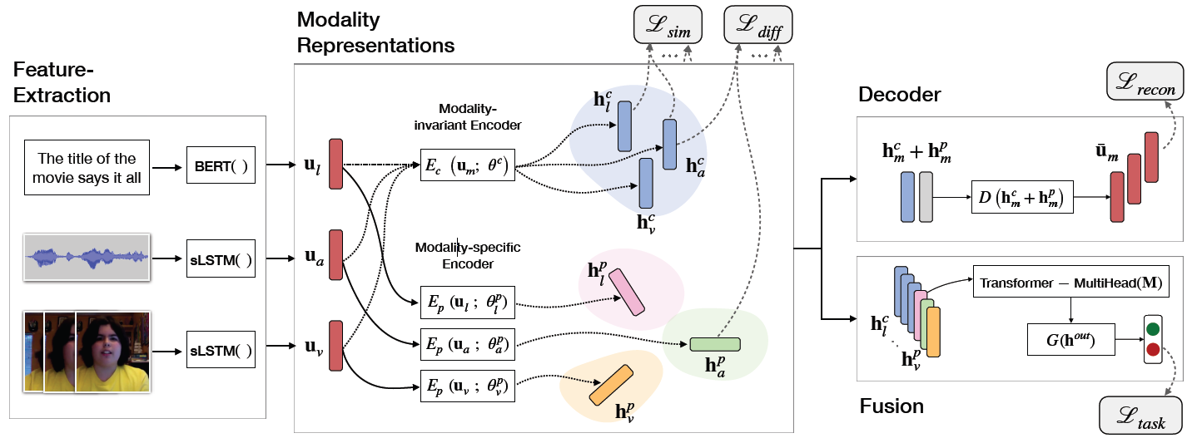
MISA Architecture

Slide 14
MISA Architecture
1. Feature Extraction
  Text, audio, and visual features are extracted using modality-specific BiLSTM encoders.
2. Representation Learning
  Shared Encoder: Captures common semantic information across modalities.
  Private Encoder: Captures unique characteristics of each modality.
3. Representation Optimization
  CMD Loss: Aligns shared representations across modalities.
  Difference Loss: Separates shared and private representations.
  Reconstruction Loss: Preserves useful information by reconstructing the original features.
4. Multimodal Fusion
  Shared and private representations are fused using a Transformer encoder.
5. Classification
  The fused representation is passed to a fully connected layer for final sentiment or intent prediction.

Slide 15
Dataset Profile & MISA Performance
Dataset Name | Total Raw Videos | Number of Classes & Task Setup | MISA Accuracy | MISA F1-Score
CMU-MOSI | 93 videos | 2 (Binary: Positive vs Negative Sentiment) | 83.4% | 83.6%
CMU-MOSEI | 3,228 videos | 2 (Binary: Positive vs Negative Sentiment) | 85.5% | 85.3%
UR_FUNNY | 829 TED Talks | 2 Classes (Binary: Humorous vs Non-Humorous) | 70.6% | ----

Slide 16
Conclusion
  Successfully reproduced the TCL-MAP framework on the MIntRec dataset.
  Achieved 73.48% Accuracy and 73.02% Weighted F1-score, closely matching the original paper.
  Comparative analysis showed that TCL-MAP outperforms MISA through modality-aware prompting and token-level contrastive learning.
  Applying the reproduced model to IntentHQ resulted in lower performance (47% Accuracy), highlighting the challenges of cross-dataset generalization.
  This study demonstrates the importance of effective multimodal feature alignment and fusion for robust intent recognition.

Slide 17
Future Work
  Integrate Supervised Contrastive Loss to improve discrimination between similar intent classes.
  Explore CORAL/CMD-based modality alignment to better align video, audio, and text representations.
  Investigate prototype memory and reasoning modules for context-aware intent understanding.
  Evaluate the proposed improvements on MIntRec and additional multimodal intent recognition datasets.
  Perform comprehensive ablation studies to analyze the contribution of each proposed module.

Slide 18
References
  Hochreiter, S., & Schmidhuber, J. (1997). Long Short-Term Memory. Neural Computation, 9(8), 1735–1780.
  Hazarika, D., et al. (2020). MISA: Modality-Invariant and Modality-Specific Representations for Multimodal Sentiment Analysis. ACM Multimedia (MM '20).
  Q. Zhou et al., "Beyond Real vs. Fake: Towards Intent-Aware Video Analysis," IEEE Transactions on Biometrics, Behavior, and Identity Science (TBIOM), 2026.
  IntentHQ Dataset: A Multimodal Intent Recognition Dataset for Intent-Aware Video Understanding.
  Devlin, J., Chang, M. W., Lee, K., & Toutanova, K. (2019). BERT: Pre-training of Deep Bidirectional Transformers for Language Understanding. NAACL-HLT.
  Paszke, A., et al. (2019). PyTorch: An Imperative Style, High-Performance Deep Learning Library. NeurIPS.
  H. Zhang et al., "MIntRec: A New Dataset for Multimodal Intent Recognition," Proc. ACM Multimedia (MM), 2022.
  T. Saha et al., "MELD-DA: A Multimodal Multi-Party Dataset for Emotion Recognition in Conversations with Dialogue Acts and Intent Annotations," Proc. COLING, 2020.

Slide 19
Thank You

Slide 20
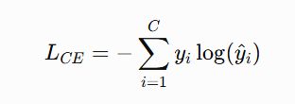
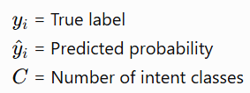
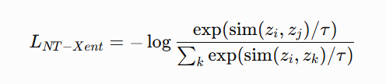
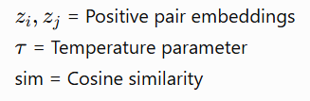

TCl MAP LOSS Function
1. Cross-Entropy Loss (Intent Classification)
  Minimizes the difference between predicted and true intent labels.
  NT-Xent Loss (Token-Level Contrastive Learning)
  Brings representations of the same intent closer.
  Pushes representations of different intents farther apart.

Slide 21
MISA's Solution: Disentanglement
Learning Objectives
  Similarity Loss
    Bring shared representations closer.
  Difference Loss
    Separate shared and private information.
  Reconstruction Loss
    Preserve important information.
Benefit
✓ Better multimodal alignment
✓ Reduced modality gap
✓ Improved sentiment/emotion prediction

Slide 22
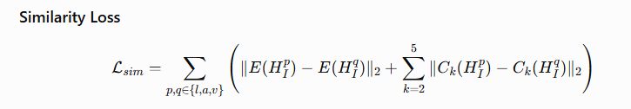
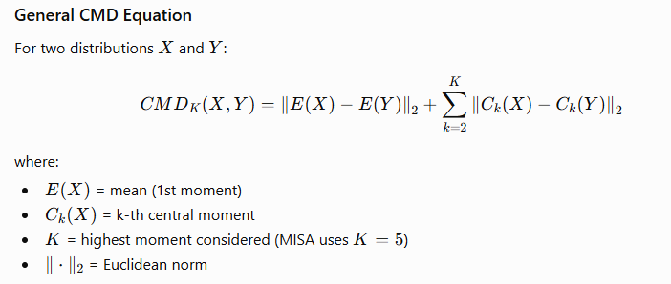
Modality-Invariant Space & Similarity Loss
Goal:
  Learn a shared representation where text, audio, and video express the same underlying sentiment/emotion.
  Instead of directly forcing feature vectors to be identical, MISA aligns their distributions using Central Moment Discrepancy (CMD).

Slide 23
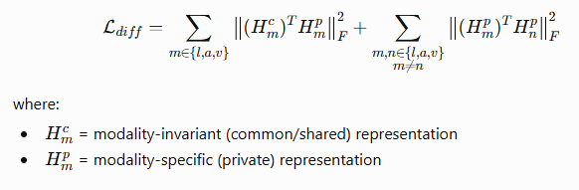
Difference Loss
Purpose
  Ensures that the shared (modality-invariant) and private (modality-specific) representations learn different information and do not overlap.

Slide 24
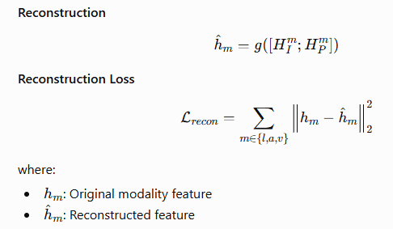
Reconstruction Loss
Purpose
  Ensures that shared and private representations together preserve all important information from the original feature.
  Prevents information loss during representation learning.
Working
  Concatenate shared and private representations.
  Pass them through a decoder to reconstruct the original feature.
  Minimize the reconstruction error.
Key Idea
  Shared representation learns common semantics.
  Private representation learns modality-specific characteristics.
  Their combination should reconstruct the original feature accurately.

Slide 25
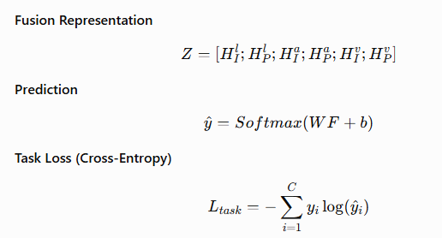
Task Loss: Optimizing Prediction Accuracy
  Train the model to predict the correct sentiment/emotion label.
  Guides final classification
  Updates all network parameters through backpropagation
  Ensures learned representations are useful for the downstream task

